Slide 1
Geometric Algorithms -
Intersections

Slide 2
Tablet Geometry
SUB: What is Points[6.4]?
Basic structure – Stroke: sequence of points
  Himetric coordinates
  HIMETRIC is used for setting coordinates of screen objects
  Coordinates are stored in an array of Points

Slide 3
Computational Geometry
Algorithms for geometric computation
Numerical issues with coordinates
Importance of degenerate cases
Examples of degenerate cases
  Three lines intersecting at a point
  Segments overlapping
  Three points co-linear

Slide 4
Basic geometry
p₂
Point
  p
Line segment
  (p₁, p₂)
Distance
  Dist(p₁, p₂)
Basic Test
  LeftOf(p₁, p₂, p₃)
  CCW(p₁, p₂, p₃)
  Counter Clockwise test
p
p₁
p₃
p₂
p₁

Slide 5
Distance computation
Avoid computing square root when possible
Example: find closest point to q
closestSoFar = p1;
d = Dist(p1, q);
for k = 2 to n {
d1 = Dist(pk, q)
if (d1 < d){
closestSoFar = pk;
d = d1;
}
}

Slide 6
Counter Clockwise Test
CCW(p₁, p₂, p₃)
public static bool CcwTest(Point p1, Point p2, Point p3){
int q1 = (p1.Y - p2.Y)*(p3.X - p1.X);
int q2 = (p2.X - p1.X)*(p3.Y - p1.Y);
return q1 + q2 < 0;
}
ASIDE: Give derivation based on the determinant

Slide 7
Convexity
p
p
q
q
convex
non-convex
Set X is convex if p,q∈X ⇒ pq⊂ X
Point p∈ X is an extreme point if there exists a line (hyperplane) through p such that all other points of X lie strictly to one side
Fact: If X=S is a finite set of points in 2D, then CH(X) is a convex polygon whose vertices (extreme points) are points of S.
Extreme points in red
r
p
q

Slide 8
Fundamental Problem: 2D Convex Hulls
More generally:
CH(polygons)
Input: n points S = (p₁, p₂, …, p_{n})
Output: A boundary representation, e.g., ordered list of vertices (extreme points), of the convex hull, CH(S), of S (convex polygon)
p₂
p₇
p₄
p₈
p₃
p₁
p₆
p₅
p₉
Output: (9,6,4,2,7,8,5)

Slide 9
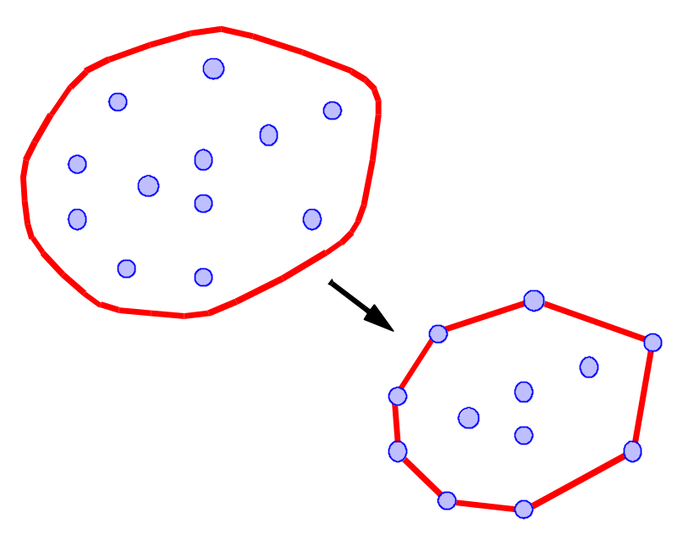
What is a Convex Hull?
Let S be a set of points in the plane.
Intuition: Imagine the points of S as being pegs; the convex hull of S is the shape of a rubber-band stretched around the pegs.
Formal definition: the convex hull of S is the smallest convex polygon that contains all the points of S.

Slide 10
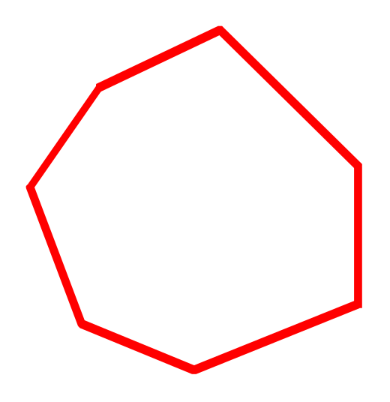

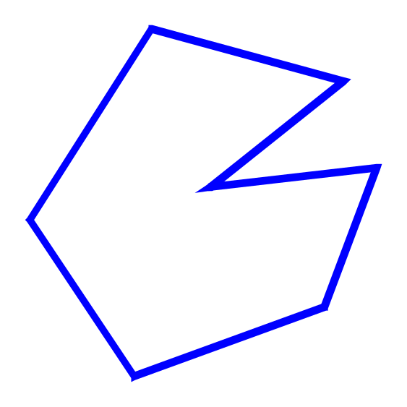
Convexity
convex
A polygon P is said to be convex if:
  P is non-intersecting; and
  for any two points p and q on the boundary of P, segment pq lies entirely inside P
Non convex

Slide 11
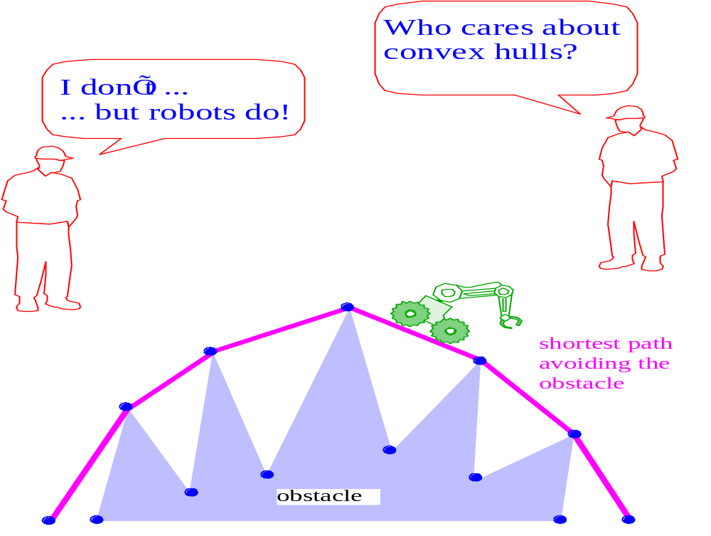
Why Convex Hulls?

Slide 12

The Package Wrapping Algorithm
Idea: Think of wrapping a package. Put the paper in contact with the package and continue to wrap around from one surface to the next until you get all the way around.

Slide 13
Intersection Problem
Intersection Detection:
Given two geometric objects, do they intersect?
Intersection detection (test) is frequently easier than the corresponding construction problem

Slide 14
Intersection Problem
Pairwise Intersection:
Given n geometric objects,
determine whether any two intersect?
report all intersecting pairs.
For testing problem we look for an algorithm that avoids testing each object against every other object.

Slide 15
Intersection of convex polygons
Problem: Given two convex polygons, P with L vertices and Q with M vertices, compute their intersection
Brute force method: O(LM)
The intersection of a convex L-gon and a convex M-gon can be computed in θ(L+M) time.

Slide 16
Trivial method for computing intersection of convex polygons
The boundary of P∩Q consists of alternate chains of vertices of the two polygons, interspersed with points at which the boundaries intersect.
P
Q
P∩Q
Red, Black, Blue, Black, …

Slide 17
Trivial method for computing intersection of convex polygons
To proceed around P, edge by edge, finding all of the boundary intersection point involving Q and keeping a list of the intersection points and vertices along the way.
This takes O(LM) time because each edge of P will be checked against every edge of Q to see if they intersect.
Can this method generalize to solve the intersection of two general polygons ? YES

Slide 18
θ(L+M) algorithm for computing intersection of convex polygons
The approach consists in subdividing the plane into regions, in each of which the intersection of the two polygons can be easily computed.
Inside a slab each polygon
forms a trapezoid

Slide 19
θ(L+M) algorithm for computing intersection of convex polygons
To partition plane into regions. O(L+M) merge-sort
  The boundary of each polygon is divided into two monotone chains by the left and right extreme points.
  Perform a plane-sweep algorithm (merge-sort) from left to right to partition the interior of each polygon into trapezoids.
The key observation is that in each slab, the intersection of P and Q is an intersection of two quadrilaterals, which can be found in O(1) time. The resulting pieces can be fitted together in O(L+M) time. O(L+M)
Question: Can this method generalize to solve the intersection of two star-shaped polygons or two general polygons ? NO

Slide 20
Intersection of star-shaped polygons
Problem: Given two star-shaped polygons, P and Q, compute their intersection
P
Q
Figure 1

Slide 21
Intersection of star-shaped polygons
The intersection of two star-shaped polygons P & Q is not a polygon, but is a union of many polygons.
In figure 1, P & Q both have n vertices, and every edge of P intersects every edge of Q, so the intersection has order of n² vertices.

Slide 22
Intersection of star-shaped polygons 1
Theorem: Finding the intersection of two star-shaped polygons requires Ω(n²) time in the worst case.

Slide 23
Intersection of general polygons
Problem: Given two general polygons, P and Q, compute their intersection

Slide 24
Intersection computation
The intersection of two convex polygons: Θ(n)
The intersection of two star-shaped polygons: Θ(n²).
The intersection of two general polygons: Θ(n²).
But it may not be necessary to spend this much time if we only want to know whether two polygons P & Q intersect at all.

Slide 25
Intersection of line segments
Problem (Line Segment Intersection Test) Given n line segments in the plane, determine whether any two intersect.
Brute-force: Take each pair of segments and determine whether they intersect. This takes O(n²) time.
Theorem: Whether any two of n line segments in the plane intersect, can be determined in Θ(n log n) time.

Slide 26
Polygon Intersection Test
Problem (Polygon Intersection Test)
Given two simple polygons P and Q, determine if they intersect.
Polygon Intersection Test ∝_{O(n)} Line Segment Intersection Test
  Detect any edge intersection between P and Q by using the Line Segment Intersection Test.
  If no intersection is found, we must test whether P⊆Q or Q⊆P. If P⊆Q, then every vertex of P is internal to Q, so we may apply the single-shot point inclusion test in O(n) time using any vertex of P.

Slide 27
Simple Polygon Test
Problem (Simplicity Test)
Given a polygon, determine if it is simple.
Simplicity Test ∝_{O(n)} Line Segment Intersection Test

Slide 28
Line segment Intersection Problem in R¹
Suppose we are given n intervals on the real line and wish to know whether any two overlap.
This can be answered in O(n²) time by inspecting all pairs of intervals
If we sort the 2n endpoints of the intervals and designate them as either right or left, then the intervals themselves are disjoint if and only if the endpoints occur in alternating order: L R L R... R L R. This test can be performed in O(n log n) time.
R
L
R
L
R
L
L
R
L
R
L
L
R
R
L
R
L
R

Slide 29
Two questions:
  Can this algorithm be improved?
  Can it generalize to two dimensions, i.e. to the case when the line segments are arbitrarily oriented?

Slide 30
Lower Bound
Element Uniqueness (Element Distinctness) Problem (Given n real numbers, are they all distinct ?) requires Ω(n log n) time in algebraic computation tree computation model
Element Uniqueness ∝_{O(n)} Interval Overlap.
  Given a collection of n real numbers x_{i}, they can be converted in linear time to n intervals [x_{i}, x_{i}]. These intervals overlap if and only if the original points are not distinct.
We conclude that Θ(n log n) comparisons are necessary and sufficient to determine whether n intervals in R¹ are disjoint.

Slide 31
Generalize Interval Overlap Problem in R¹ to R²
The idea behind Interval Overlap Algorithm in R¹: If any two intervals contain a point of the same x-coord, then the two intervals overlap.
The idea behind Line Segment Intersection Algorithm in R²: Even though two line-segments contain a point of the same x-coord., i.e. both are intersected by a vertical line, it doesn’t mean that these two line-segments intersect.
For each vertical line L, the line segments intersected by L are ordered in y-coord. by their intersections.
When two line segment cross each other, they must be adjacent in y-coord. for some vertical line L.

Slide 32
Line-segment Intersection Algorithm
Line-segment Intersection problem can be solved by plane-sweep technique.
Plane-sweep technique makes use of two basic data structures: the sweep-line status and the event-point schedule.

Slide 33
Line-segment Intersection Algorithm
sweep-line status: a data structure maintaining the ordering of line segments intersecting with a given sweep line L and must support the following operations: (a height-balanced tree will do)
  INSERT(s, L). Insert segment s into the total order maintained by L. O(log n)
  DELETE(s, L). Delete segment s from L. O(log n)
  ABOVE(s, L). Return the name of the segment immediately above s in the ordering. O(1)
  BELOW(s, L). Return the name of the segment immediately below s in the ordering. O(1)

Slide 34
Line-segment Intersection Algorithm
event-point schedule: a data structure recording the ordering of events at which the sweep-line status changes and it must support the following operation: (A min-priority queue will do)
  MIN(E). Determine the smallest element in E and delete it O(log n)
  INSERT(x, E). Insert abscissa x into the total order maintained by E. O(log n)
  MEMBER(x, E). Determine if abscissa x is a member of E. O(log n)

Slide 35
Line-segment Intersection Algorithm
The ordering of line segments can change in only three ways for each sweep-line:
1. At the left endpoint of segment s. In this case s must be added to the ordering.
2. At the right endpoint of segment s. In this case s must be removed from the ordering.
3. At an intersection point of two segments s₁ and s₂. Here s₁ and s₂ exchange places in the ordering.

Slide 36
Line-segment Intersection Algorithm
We now outline the algorithm: as the vertical line sweeps the plane, at each event point sweep-line status L is updated and all pairs of segments that become adjacent in this update are checked for intersection.
s₁
s₂
S₁ = ABOVE(s₂, L)
S₃ = BELOW(s₂, L)
s₃

Slide 37
Line-segment Intersection Algorithm
procedure LINE SEGMENT INTERSECTION
sort the 2n endpoints lexicographically by x and y and place them into priority queue E;
A := ∅
while (E ≠ ∅) do
p := MIN(E);
if (p is left endpoint)
then HANDLE LEFT EVENT(p);
else if (p is a right endpoint)
then HANDLE RIGHT EVENT(p);
else HANDLE INTERSECTION EVENT(p); /*P is an intersection*/
while (A ≠ ∅) do
(s, s') ← A;
x := common abscissa of s and s';
if (MEMBER(x, E) = FALSE)
then output (s, s');
INSERT(x, E);

Slide 38
Line-segment Intersection Algorithm
HANDLE LEFT EVENT(p)
s:= segment of which p is an endpoint;
INSERT(s, L);
s₁ := ABOVE(s, L);
s₂ := BELOW(s, L);
if (s₁ intersects s) then A ← (s₁, s);
if (s₂ intersects s) then A ← (s₂, s);

Slide 39
Line-segment Intersection Algorithm
HANDLE RIGHT EVENT(p)
s:= segment of which p is an endpoint;
s₁ := ABOVE(s, L);
s₂ := BELOW(s, L);
if (s₁ intersects s₂ to the right of p)
then A ← (s₁, s₂);
DELETE(s, L);

Slide 40
Line-segment Intersection Algorithm
HANDLE INTERSECTION EVENT(p)
(s₁, s₂) := segment of which p is intersection;
/* with s₁ = ABOVE(s₂) to the left of p */
s₃ := ABOVE(s₁, L);
s₄ := BELOW(s₂, L);
if (s₃ intersects s₂) then A ← (s₃, s₂);
if (s₁ intersects s₄) then A ← (s₁, s₄);

Slide 41
Line-segment Intersection Algorithm
That no intersection is missed by this algorithm follows from the observation that only adjacent segments may intersect and that all adjacencies are correctly examined at least once.

Slide 42
Example

Slide 43
Problem (Line Segment Intersection)
Given n line segments in the plane, find all intersecting pairs.
Theorem[Bentley-Ottmann(1979)]: The I intersecting pairs of a set of n line segments can be reported in time O((n+I) log n).
Theorem[Chazelle-Edelsbrunner(1988)]: The I intersecting pairs of a set of n line segments can be reported in time O(n log n+I).

Slide 44
Resume
The intersection of two convex polygons: Θ(n)
Pairwise Line Segment Intersection: O(n log n+I)
The intersection of two star-shaped polygons: Θ(n²)
The intersection of two general polygons: Θ(n²)
Line Segment Intersection Test: Θ(n log n)
Polygon Intersection Test: Θ(n log n)
Polygon Simplicity Test: Θ(n log n)

Slide 45
Conclusions
Convex Hull

